Slide 1
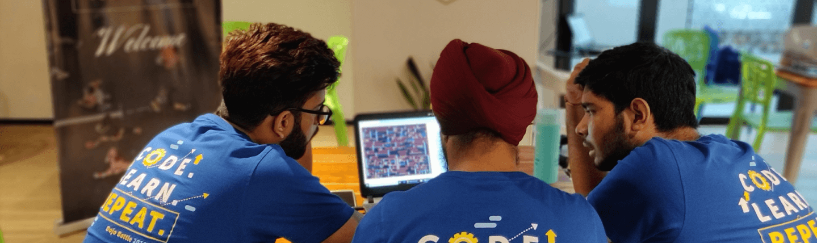
Day in the life of a Modern Engineer

Slide 2

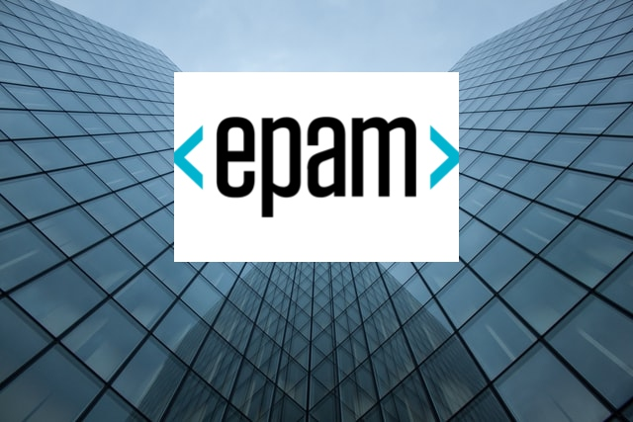
Madan Sudarman
DIRECTOR - TECHNOLOGY SOLUTIONS

Slide 3

2020 - 2021

Slide 4


Slide 5

The Cloud-Native Way

Slide 6
Software Engineer
Cloud Native Engineer
MODERN
Notes:
Software Engineer:
Language agnostic development
Full-stack development
…
Solution Architect:
Provider specific Cloud Services
Deployment Models: Private, Public, Multi, Hybrid clouds
…
Security Engineer
Cloud Security on Application, Infrastructure, UI, and Data level
Compliance risks
Cloud Authentication
…
DevOps Engineer
Containers and orchestration
Release Engineering
…

Slide 7

Business Priorities

Slide 8
Cloud Adoption – Dynamics
Cloud Watchers
Cloud Beginners
Cloud Explorers
Cloud Focused
Cloud maturity model
Business Agility
Innovation

Slide 9
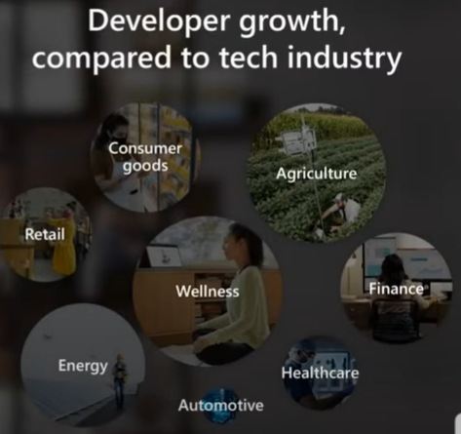

Ignite 2021 - Digital First responders

Slide 10
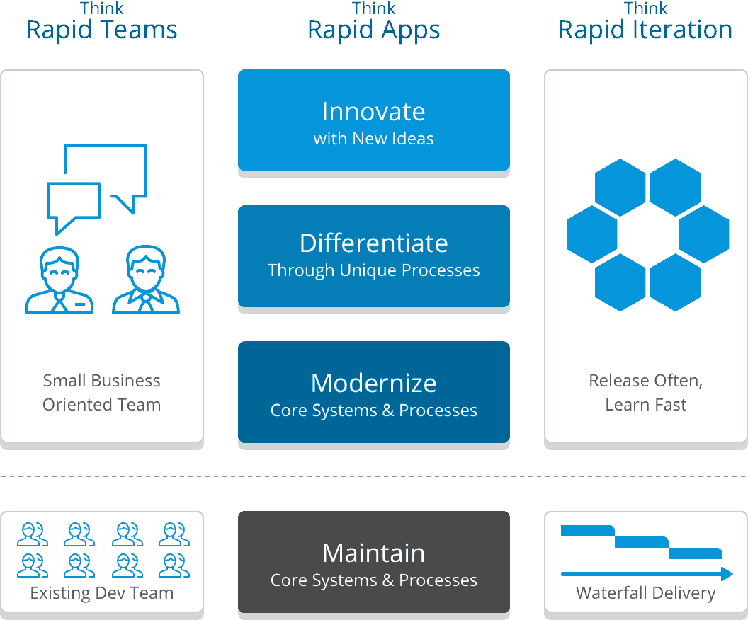
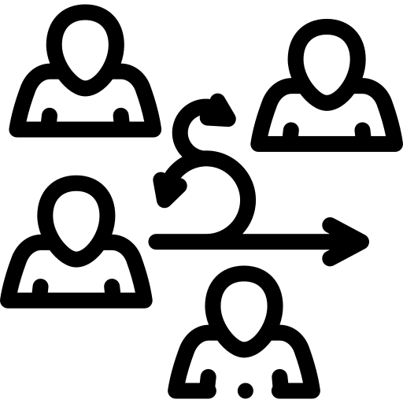
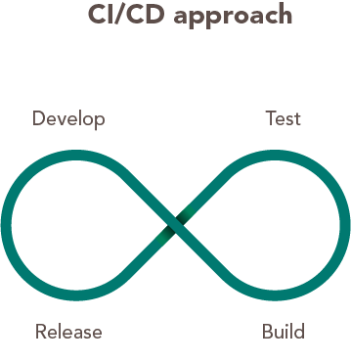
Typical Cloud Adoption
Digital First Responders
Agile
DevOps

Slide 11
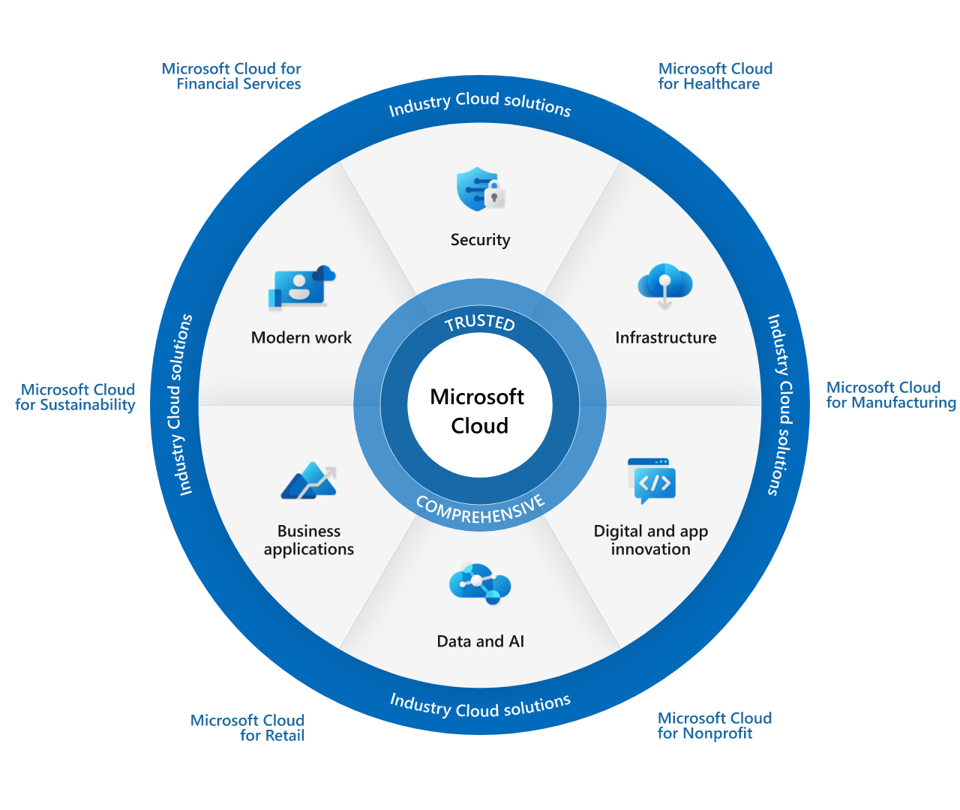

Slide 12

Modern Software Engineer

Slide 13
Site Reliability
Engineer
Cloud Native Engineer
Combines Expertise in a Wide Range of Adjunct Disciplines
Software Engineer
Security Engineer
DevOps Engineer
Notes:
Software Engineer:
Language agnostic development
Full-stack development
…
Solution Architect:
Provider specific Cloud Services
Deployment Models: Private, Public, Multi, Hybrid clouds
…
Security Engineer
Cloud Security on Application, Infrastructure, UI, and Data level
Compliance risks
Cloud Authentication
…
DevOps Engineer
Containers and orchestration
Release Engineering
…

Slide 14


Slide 15
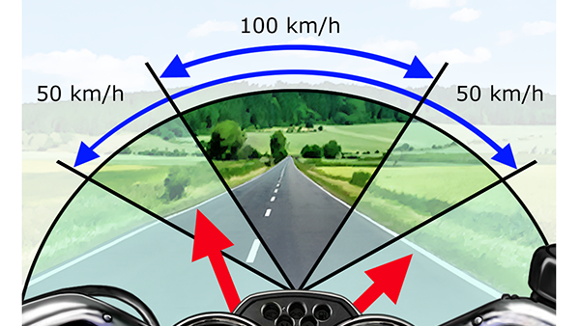
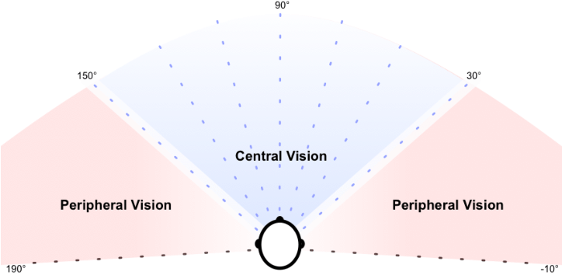
Cloud Native Engineer
Software Engineer
Site Reliability
Engineer
Security
Engineer

Slide 16
Software Engineer
Cloud Native Engineer
Notes:
Software Engineer:
Language agnostic development
Full-stack development
…
Solution Architect:
Provider specific Cloud Services
Deployment Models: Private, Public, Multi, Hybrid clouds
…
Security Engineer
Cloud Security on Application, Infrastructure, UI, and Data level
Compliance risks
Cloud Authentication
…
DevOps Engineer
Containers and orchestration
Release Engineering
…

Slide 17



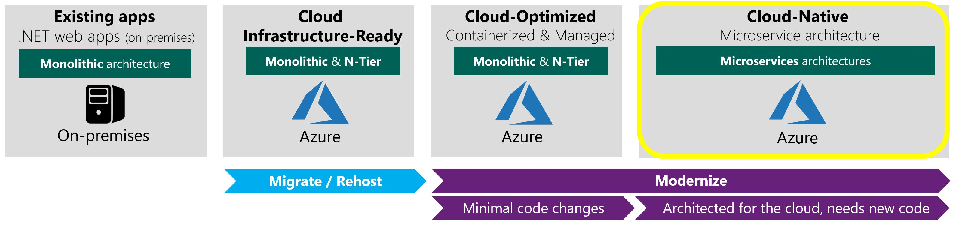
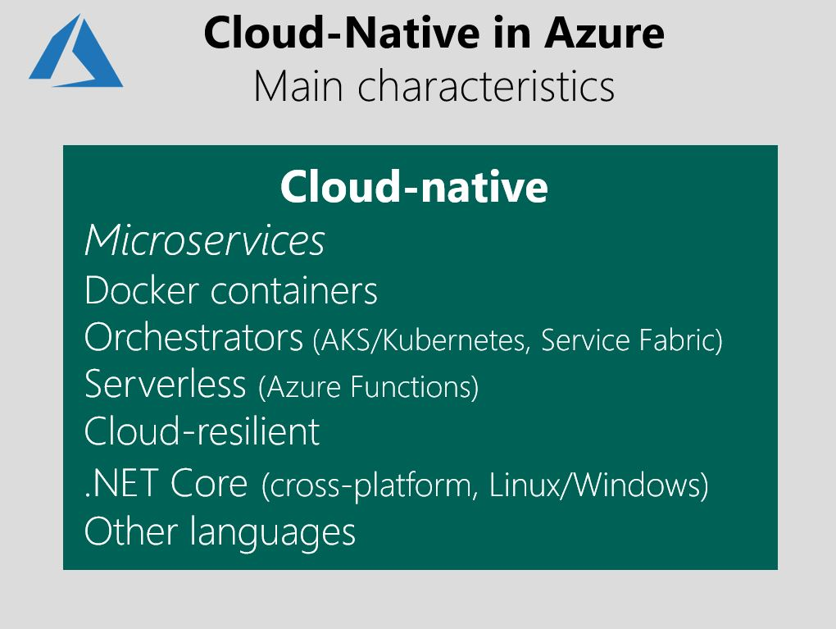
Cloud Native on Azure
- Java, Node JS etc

Slide 18
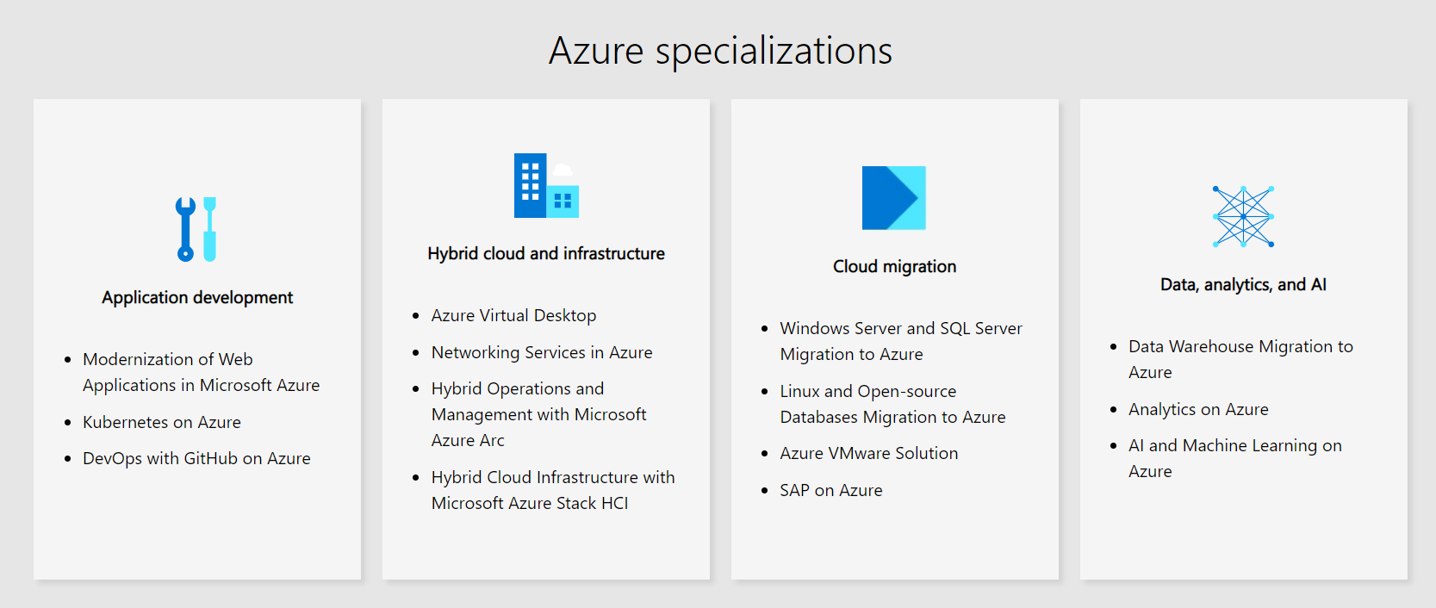
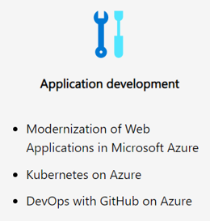
Azure Partner Program

Slide 19

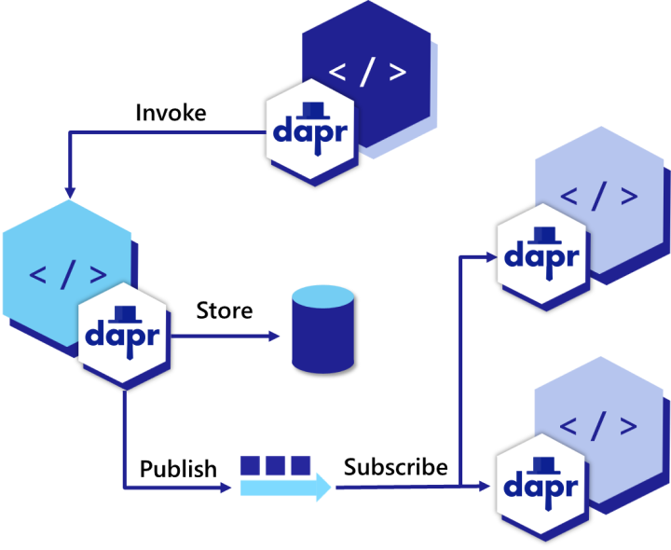
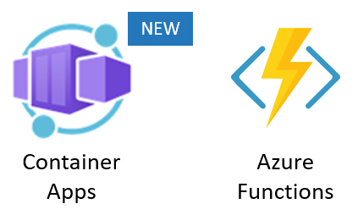


Tech Stack - Common Denominator

Slide 20
Cloud Native Traits
Client Centric
Domain Driven Design
API First
Design Patterns
12 Factor App
Continuous Improvement
Well Architected Framework

Slide 21
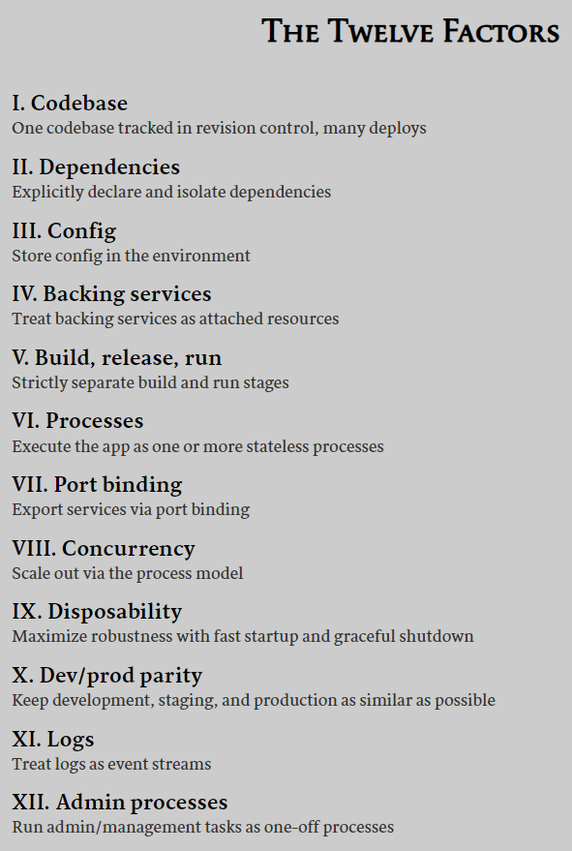
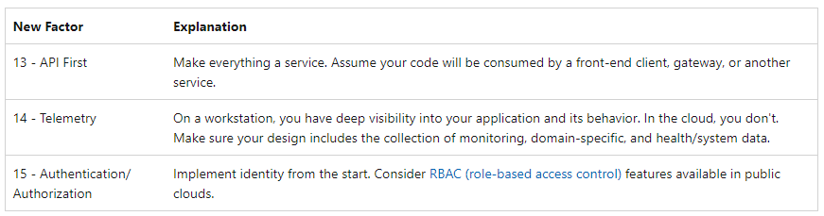
Extra factors that reflect today’s
modern cloud application design

Slide 22
Cloud Native Traits and Capabilities by Roles
Cloud Native Traits | Cloud Native Architect | Cloud Native Engineer | DevOps Engineer | Site Reliability Engineer
Client Centric | Business Requirements / Capability Model Non-Functional Requirements | Wireframes, Visual designs Usage metrics | Deployment Frequency | SLI/SLO
Product Mindset | Agile Design (Minimal Upfront Design) End to End Lifecycle driven | Agile way of working Feature driven development |  | Change management Continuous Improvement
Domain Driven Design | Strategic Event storming Bounded Context / Context Maps Ubiquitous Language | Tactical Domain Model (Entity / Aggregate) Repositories / Factories / Services Domain Events
API – Rest, GraphQL | API design Patterns / best practices HTTP Maturity Model Level 2+ | HTTP methods / Status / Open API Web API / EF / Polyglot persistence BDD / TDD / Unit Test
Design Patterns | 12 Factor App Event driven / Asynchronous Backends for Frontends Strangler / Side car Well architected framework | CQRS Federated Identity Materialized view Ambassador / Anti-corruption Reliability (Bulkheads, Circuit breaker) | Pipeline Design Patterns | Quotas Graceful degradation Self healing systems
Platform | Environment - Cluster Sizing & Specifications End to End pipeline design Continuous Security Continuous Improvement | Container Image / Helm chart Code Quality / Review SAST IAST DAST | Infrastructure as Code Configuration Management Build / Release Pipeline Configurations Non-functional testing Continuous Security & Improvement | Continuous Monitoring Availability, Reliability Performance, Efficiency Chaos engineering Continuous Security

Slide 23
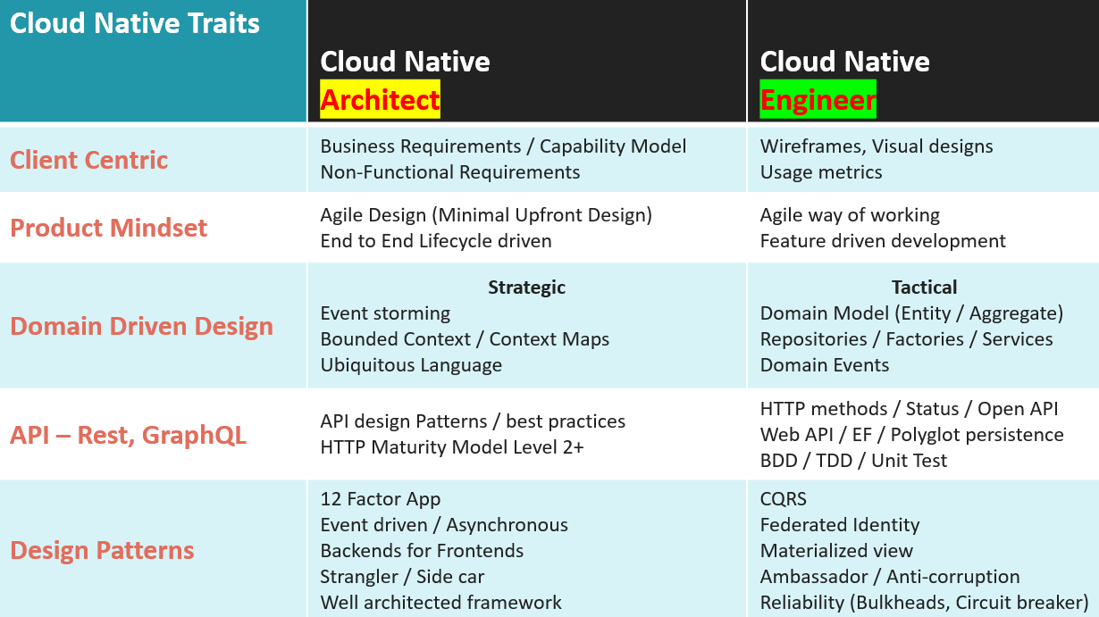

Slide 24
Site Reliability
Engineer
Cloud Native Engineer
Combines Expertise in a Wide Range of Adjunct Disciplines
Software Engineer
Security Engineer
DevOps Engineer
Notes:
Software Engineer:
Language agnostic development
Full-stack development
…
Solution Architect:
Provider specific Cloud Services
Deployment Models: Private, Public, Multi, Hybrid clouds
…
Security Engineer
Cloud Security on Application, Infrastructure, UI, and Data level
Compliance risks
Cloud Authentication
…
DevOps Engineer
Containers and orchestration
Release Engineering
…

Slide 25
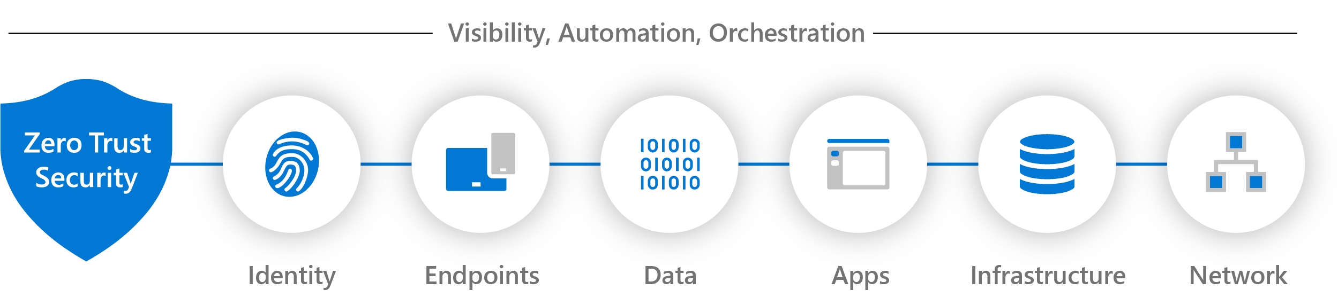
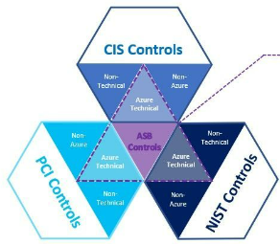
Zero Trust Security Model
Cloud Security Posture Management (CSPM)
Cloud Workload Protection (CWP)
Microsoft Security Benchmark

